Slide 1
Bootcamp Session R Programming

Slide 2
Managing Data with dplyr
select: return a subset of the columns of a data frame, using a f lexible notation
filter: extract a subset of rows from a data frame based on logical conditions
arrange: reorder rows of a data frame
rename: rename variables in a data frame
mutate: add new variables/columns or transform existing variables
summarise / summarize: generate summary statistics of different variables in the data frame,possibly within strata
%>%: the “pipe” operator is used to connect multiple verb actions together into a pipeline

Slide 3
Control Structures
• if and else: testing a condition and acting on it
• for: execute a loop a fixed number of times
• break: break the execution of a loop
• next: skip an iteration of a loop

Slide 4
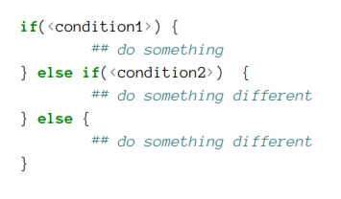
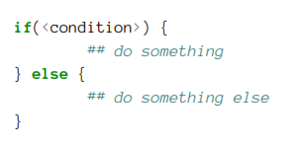
if-else
This structure allows you to test a condition and act on it depending on whether it’s true or false.

Slide 5
for Loops
In R, for loops take an iterator variable and assign it successive values from a sequence or vector.
For loops are most commonly used for iterating over the elements of an object (list, vector, etc.)

Slide 6
for Loops (contd.)
Nested for loops
for loops can be nested inside of each other.
Nesting beyond 2 to 3 levels often makes it difficult to read or understand the code.
Next next is used to skip an iteration of a loop.
Break break is used to exit a loop immediately, regardless of what iteration the loop may be on.

Slide 7
while Loops
While loops begin by testing a condition. If it is true, then they execute the loop body.
Once the loop body is executed, the condition is tested again, and so forth, until the condition is false, after which the loop exits.

Slide 8
Loop Functions
Lapply
The lapply() function does the following simple series of operations:
it loops over a list, iterating over each element in that list
it applies a function to each element of the list (a function that you specify)
and returns a list (the l is for “list”).

Slide 9
Loop Functions contd.
Sapply
The sapply() function behaves similarly to lapply();
sapply() will try to simplify the result of lapply() if possible.
Essentially, sapply() calls lapply() on its input and then applies the following algorithm:
• If the result is a list where every element is length 1, then a vector is returned
• If the result is a list where every element is a vector of the same length (> 1), a matrix is returned.
• If it can’t figure things out, a list is returned

Slide 10
Loop Functions contd.
Split()
The split() function takes a vector or other objects and splits it into groups determined by a factor or list of factors.
Using it with lapply() and sapply() is sometimes referred to as “map-reduce” in other contexts.

Slide 11
Loop Functions contd.
Tapply
tapply() is used to apply a function over subsets of a vector.
It can be thought of as a combination of split() and sapply() for vectors only.

Slide 12
Data Visualization
ggplot
The ggplot2 package allows you to quickly plot attractive graphics and to visualize and explore data.
The basic steps behind creating a plot with ggplot2 are:
Create an object of the ggplot class, typically specifying the data and some or all of the aesthetics;
Add on geoms and other elements to create and customize the plot, using +.

